Slide 1
GENERAL VIEW OF THE SMART GRID MARKET DRIVERS
Satisfy the need for increased integration of digital systems for increased efficiency of the power system.
In the restructured environment, the deregulated electric utility industry allows a renovation of the market to be based on system constraints and the seasonal and daily fluctuations in demand.
Competitive markets increase the shipment of power between regions, which further strains today’s aging grid and requires updated, real-time controls.

Slide 2
GENERAL VIEW OF THE SMART GRID MARKET DRIVERS(Cont`d)
Handle grid congestion, increase customer participation, and reduce uncertainty for investment. This requires the enhancement of the grid’s capability to handle demand reliably.
Seamlessly integrate renewable energy systems (RES) and distributed generation. The drastic increase in the integration of cost-competitive distributed generation technologies affects the power system.

Slide 3
STAKEHOLDER ROLES AND FUNCTION
SMART GRID STAKEHOLDER
UTILITIES: Installation and implementation of power grid technologies
POLICY-MAKERS: Establishment of standards for operation, monitoring, interoperability etc.
TECHNOLOGY PROVIDERS: Development of smart grid technologies for the grid enhancement
RESEARCHERS: Development of tools and technologies for the smart grid
CONSUMERS: Consumer input and participation, consumer buy-in etc.

Slide 4
Representative Architecture
Proposed smart grid divides into nine areas :
transmission automation,
system coordination
situation assessment,
system operations,
distribution automation,
renewable integration,
energy efficiency,
distributed generation and storage,
demand participation signals and options, and
smart appliances, PHEVs, and storage.

Slide 5
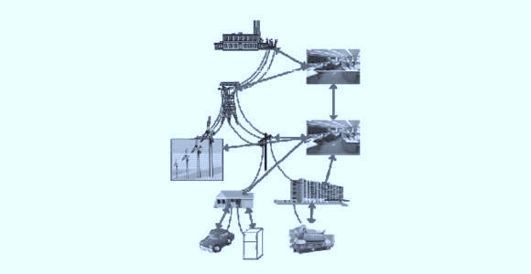
Transmission
Automation
System Coordination
Situation Assessment
Distribution
Automation
System
Operation
Renewable
Integration
Energy
Efficiency
Demand Participation
Signal & Option
Distributed Generation
and Storage
Smart Appliances
PHEVs & Storage
Representative architecture of the smart grid design

Slide 6
Functions of Smart Grid Components
The areas of application of smart grids include:
smart meters integration,
demand management,
smart integration of generated energy,
administration of storage and renewable resources,
using systems that continuously provide and use data from an energy network

Slide 7
Smart Devices Interface Component
Smart devices for monitoring and control form part of the generation components real-time information processes.
These resources need to be seamlessly integrated in the operation of both centrally distributed and district energy systems.

Slide 8
Storage Component
Due to the variability of renewable energy and the disjoint between peak availability and peak consumption, it is important to find ways to store the generated energy for later use.
Options for energy storage technologies include pumped hydro, advance batteries, flow batteries, compressed air, super-conducting magnetic energy storage, super capacitors, and flywheels.

Slide 9
Transmission Subsystem Component
The transmission system that interconnects all major substation and load centers is the backbone of an integrated power system.
Transmission lines must tolerate dynamic changes in load and contingency without service disruptions.
Efficiency and reliability at an affordable cost continues to be the ultimate aims of transmission planners and operators.

Slide 10
Monitoring and Control Technology Component
Intelligent transmission systems/assets include a smart intelligent network, self- monitoring and self-healing, and the adaptability and predictability of generation and demand robust enough to handle congestion, instability, and reliability issues.
This new resilient grid has to withstand and be reliable to provide real - time changes in its use.

Slide 11
Intelligent Grid Distribution Subsystem Component
The distribution system is the final stage in the transmission of power to end users.
Primary feeders at this voltage level supply small industrial customers and secondary distribution feeders supply residential and commercial customers.
At the distribution level, intelligent support schemes will have monitoring capabilities for automation using smart meters, communication links between consumers and utility control, energy management components, and AMI

Slide 12
Demand Side Management Component
DSM options provide reduced emissions in fuel production, lower costs, and contribute to reliability of generation.
These options have an overall impact on the utility load curve.
Demand side management options and energy efficiency options developed for effective means of modifying the consumer demand to cut operating expenses from expensive generators and defer capacity addition.

